Slide 1
TGIP Episode 014
Pulsar Schema and Flink Integration

Slide 2
Infinite Event Streams

Slide 3
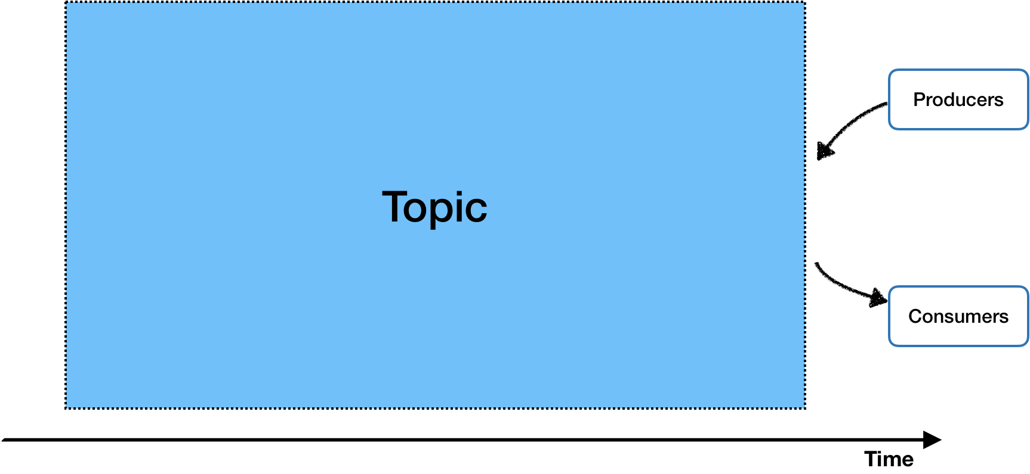
Pulsar - Pub/Sub

Slide 4
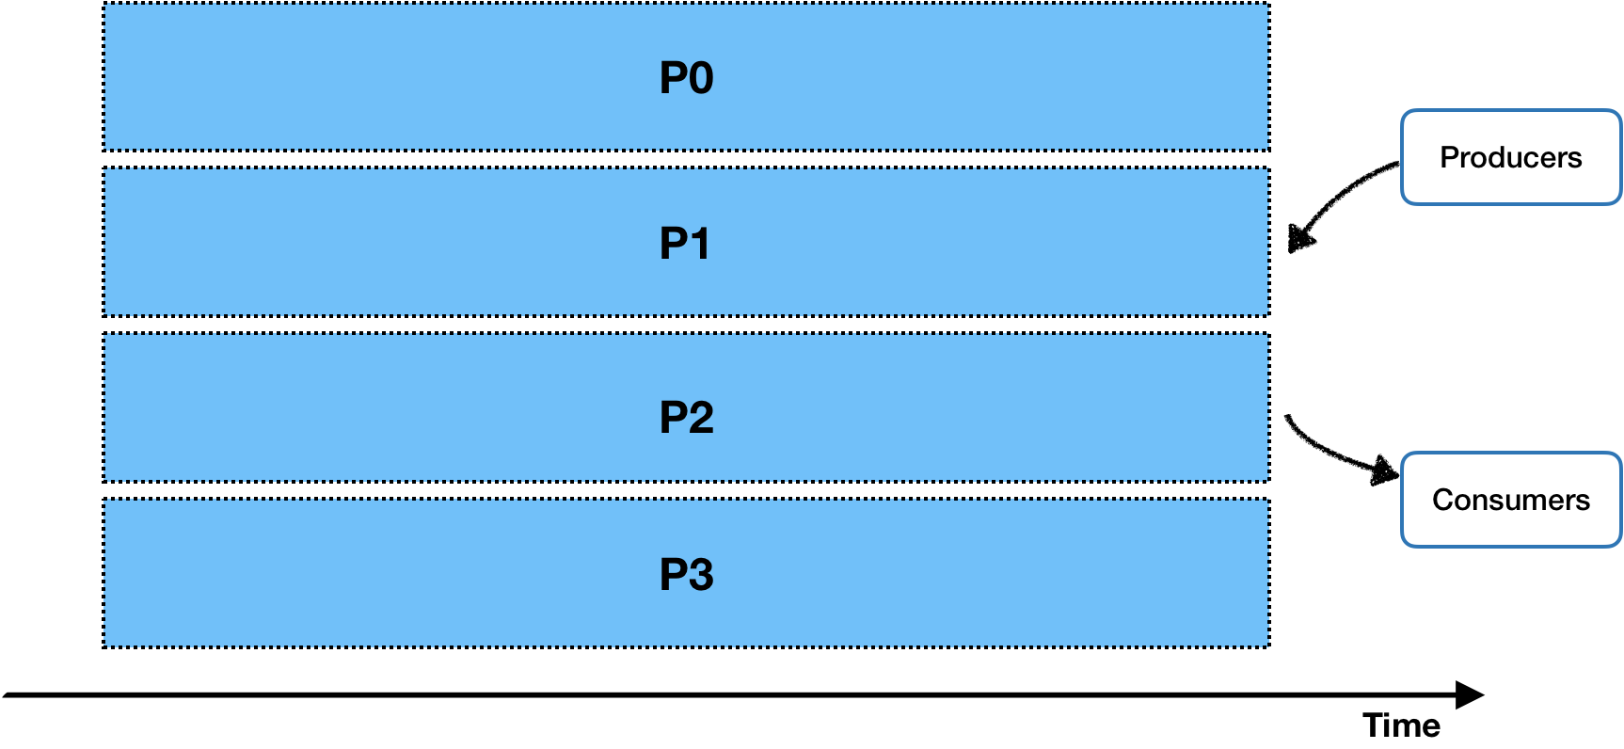
Pulsar - Topic Partitions

Slide 5
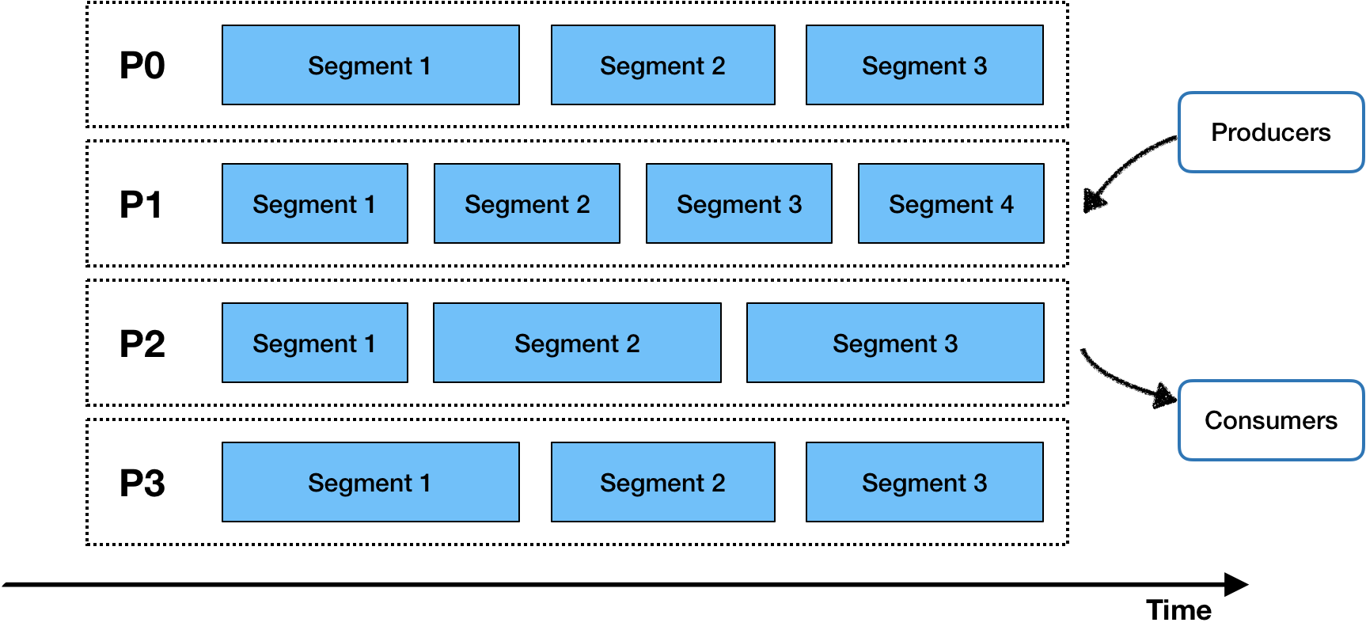
Pulsar - Segments

Slide 6
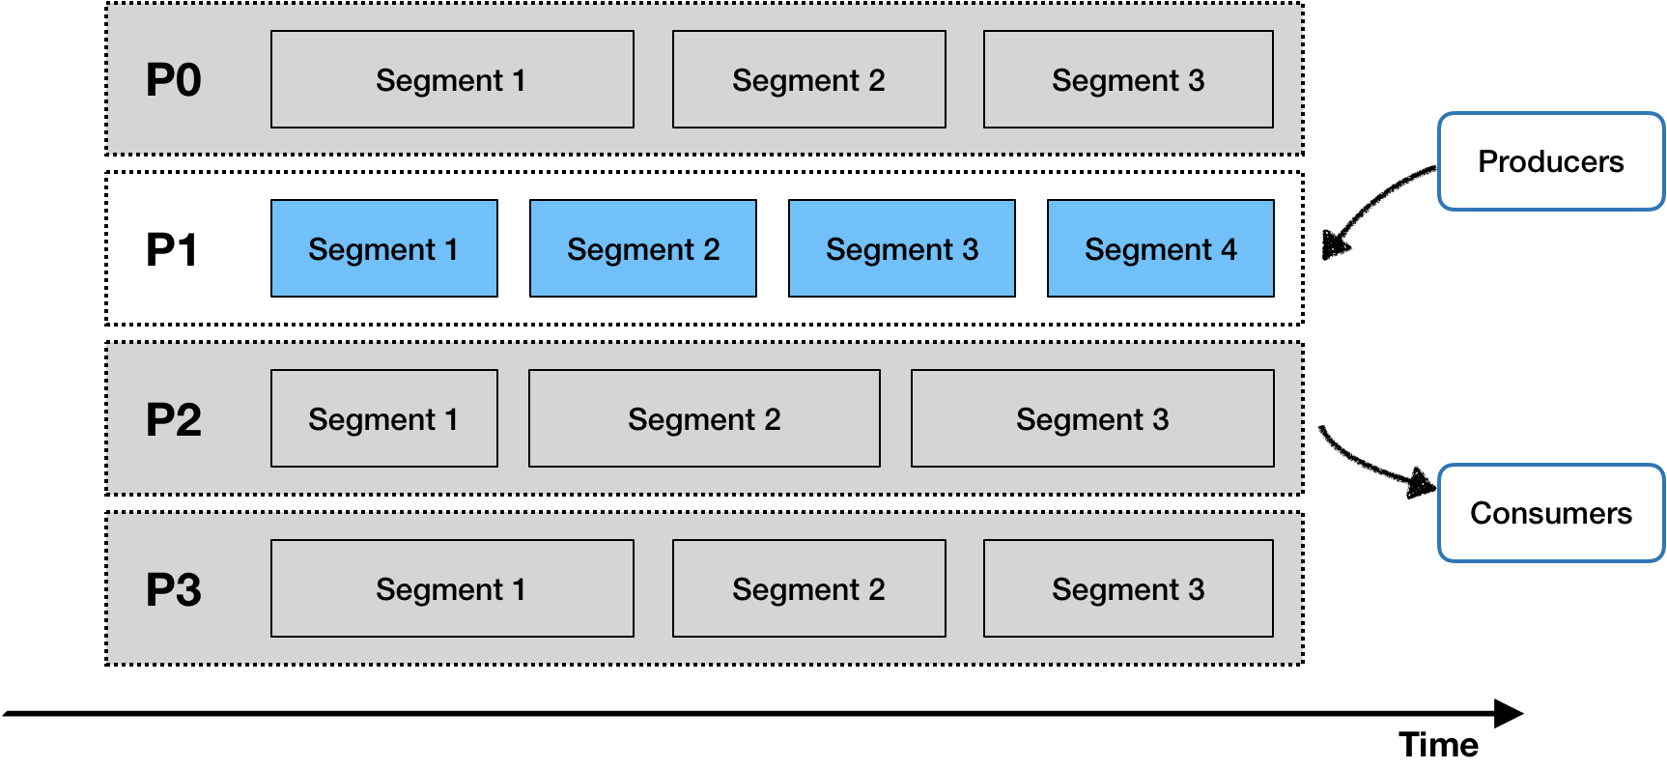
Pulsar - Event Stream

Slide 7
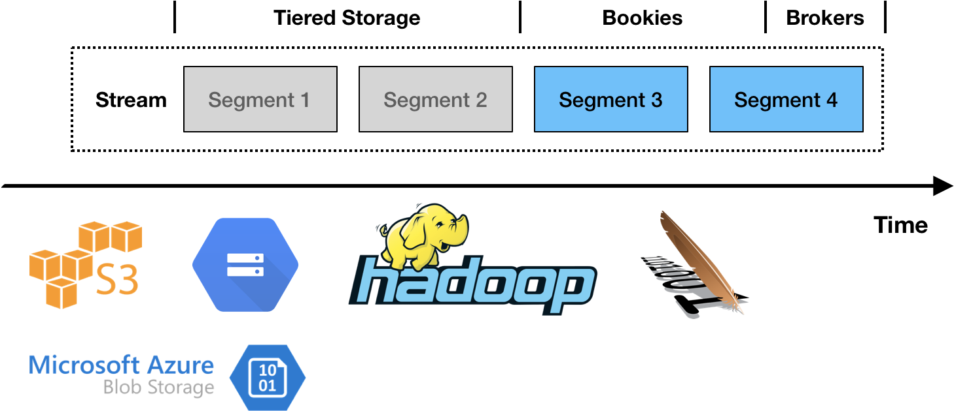
Pulsar - Infinite event stream storage

Slide 8
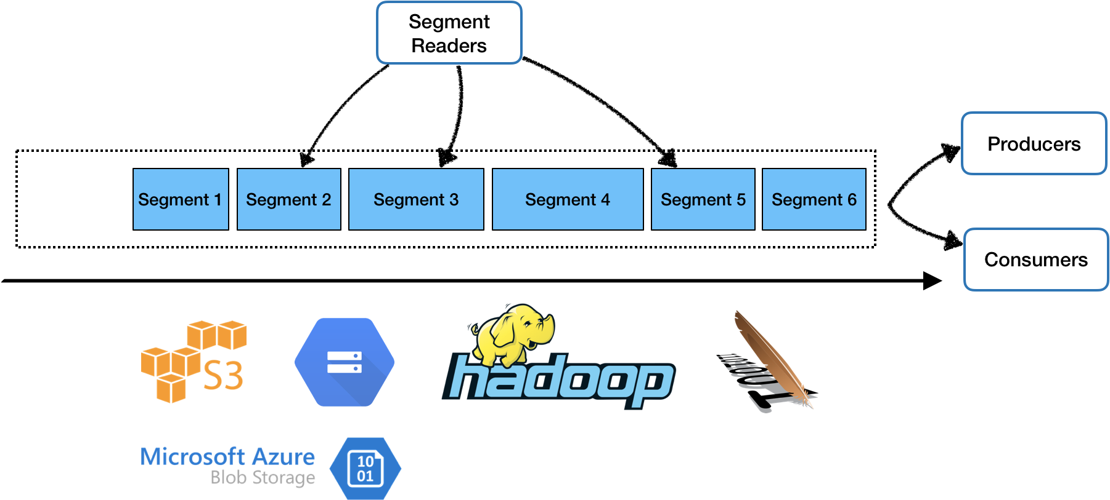
Event Stream provides a unified view on data

Slide 9
Pulsar - Two levels of reading API
Pub/Sub (Streaming)
Read data from brokers
Consume / Seek / Receive
Subscription Mode - Failover, Shared, Key_Shared
Reprocessing data by rewinding (seeking) the cursors
Segment (Batch)
Read data from storage (bookkeeper or tiered storage)
Fine-grained Parallelism
Predicate pushdown (publish timestamp)

Slide 10
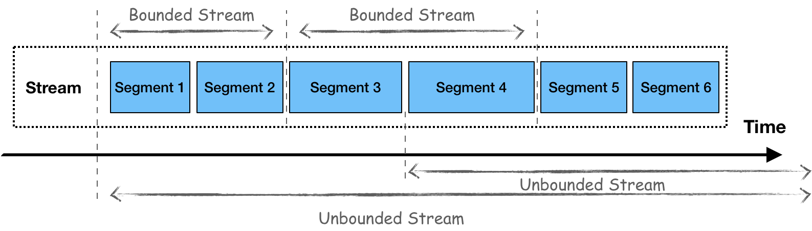
Unified data accesses on Pulsar

Slide 11
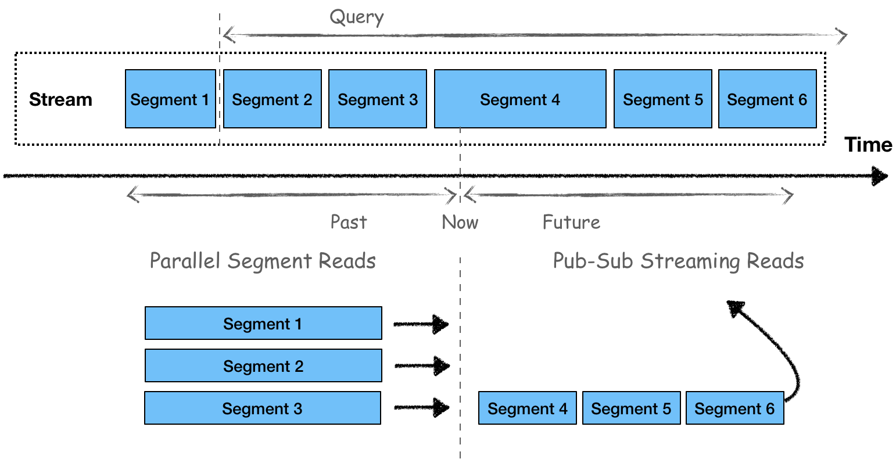
Unified Data Processing

Slide 12
Structured Event Streams

Slide 13
Pulsar Schema (1)
Consensus of data at server-side
Built-in schema registry
Data schema on a per-topic basis
Send and receive typed messages directly
Validation
Multi-version
Schema evolution & compatibilities

Slide 14
Pulsar Schema (2)
// Create producer with Struct schema and send messages
Producer<User> producer = client.newProducer(Schema.AVRO(User.class)).create();
producer.newMessage()
.value(User.builder()
.userName("pulsar-user")
.userId(1L)
.build())
.send();
// Create consumer with Struct schema and receive messages
Consumer<User> consumer = client.newConsumer(Schema.AVRO(User.class)).create();
consumer.receive();

Slide 15
Pulsar Schema (3) - SchemaInfo
{
"type": "JSON",
"schema": "{
\"type\":\"record\",
\"name\":\"User\",
\"namespace\":\"com.foo\",
\"fields\":[
{
\"name\":\"file1\",
\"type\":[\"null\",\"string\"],
\"default\":null
},
{
\"name\":\"file2\",
\"type\":\"string\",
\"default\":null
},
{
\"name\":\"file3\",
\"type\":[\"null\",\"string\"],
\"default\":\"dfdf\"
}
]
}",
"properties": {}
}

Slide 16
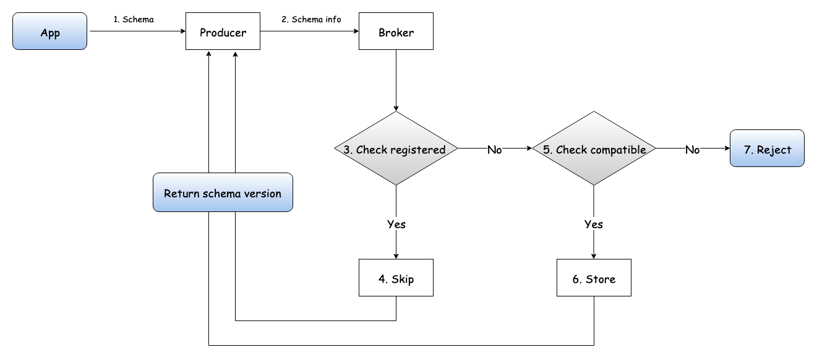
Pulsar Schema (4) - Producer

Slide 17

Pulsar Schema (5) - Consumer

Slide 18
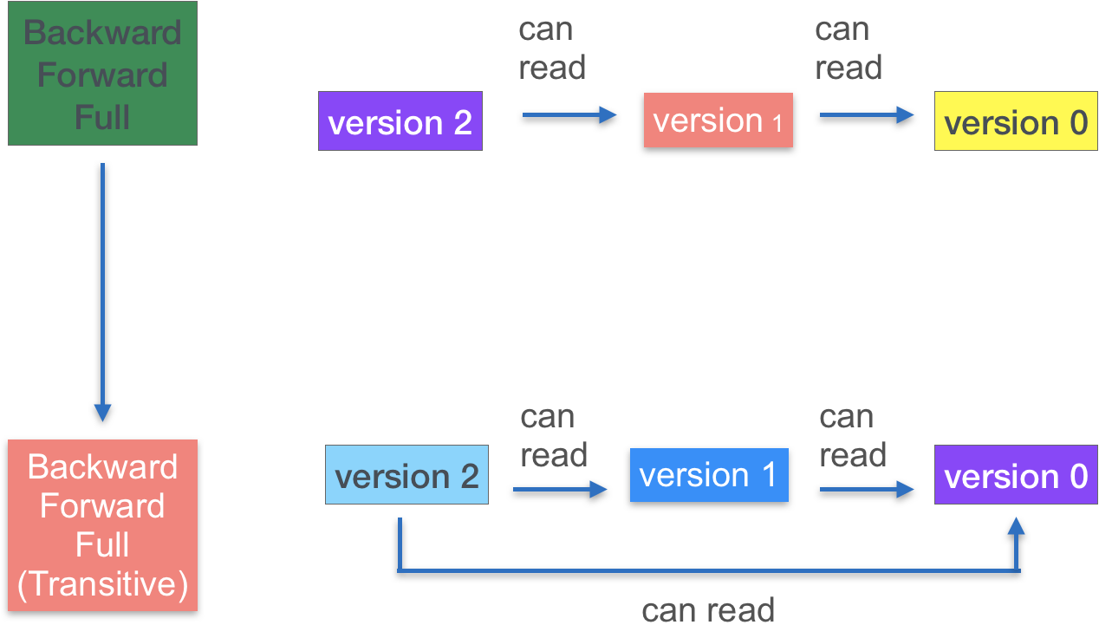
Pulsar Schema (6) - Compatibility Strategy

Slide 19
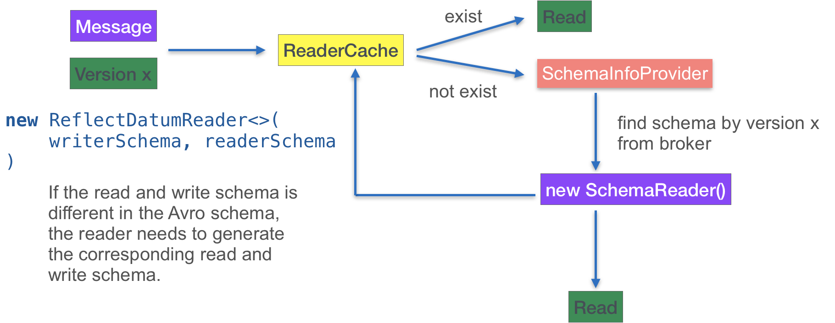
Pulsar Schema (7) - Multi versions

Slide 20
Apache Flink

Slide 21
Apache Flink
Unified computing engine
Batch processing is a special case of stream processing
Stateful processing
Popular

Slide 22
Stream <-> Table

Slide 23
Pulsar-Flink (1) - Schema <-> Row
Topics without schema or with primitive schemas
`value` field for message payload
Topics with struct schemas (AVRO, JSON)
Field names and types are kept in the row
Metadata Fields
__key: Binary
__topic: String
__messageId: Binary
__publishTime: Timestamp
__eventTime: Timestamp
https://github.com/streamnative/pulsar-flink

Slide 24
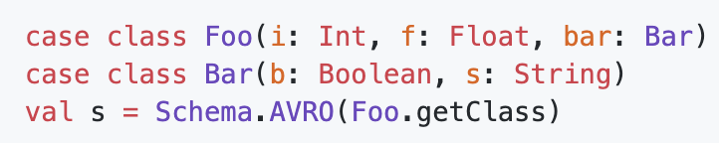
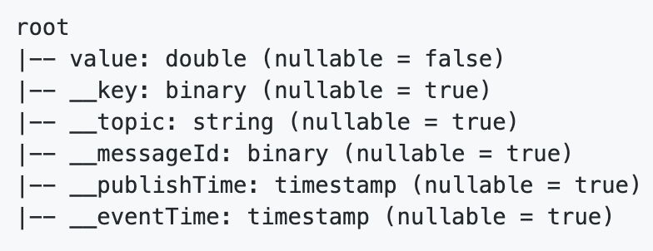
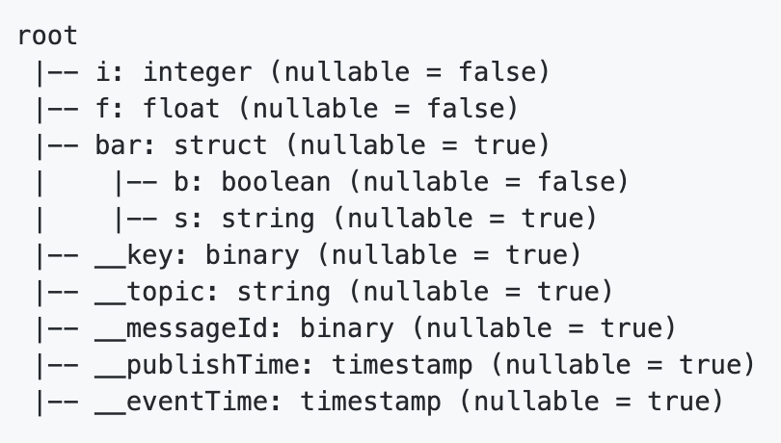
Pulsar-Flink (2) - Schema Examples
Primitive Schema
Avro Schema
https://github.com/streamnative/pulsar-flink

Slide 25
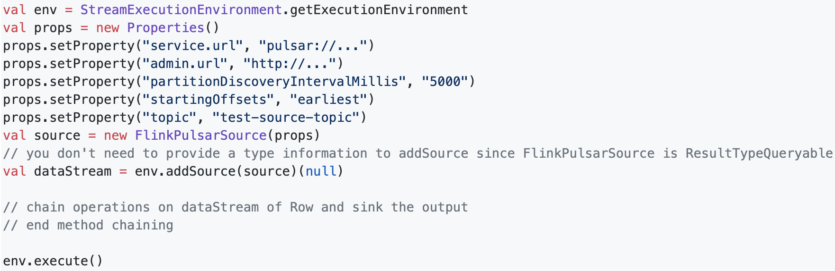
Pulsar-Flink (3) - Pulsar Source
https://github.com/streamnative/pulsar-flink

Slide 26
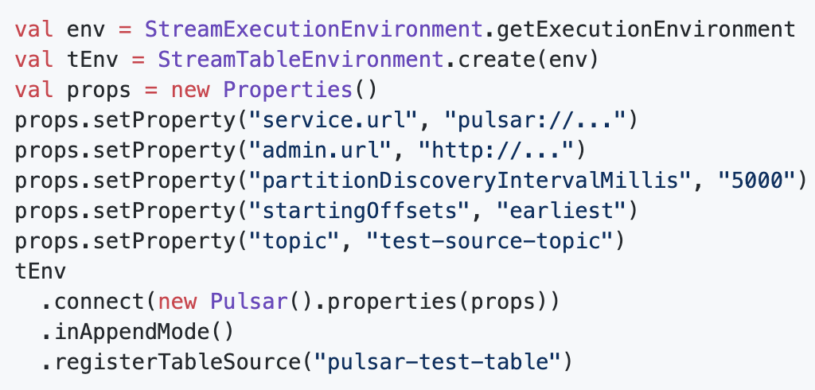
Pulsar-Flink (4) - Streaming Tables
https://github.com/streamnative/pulsar-flink

Slide 27
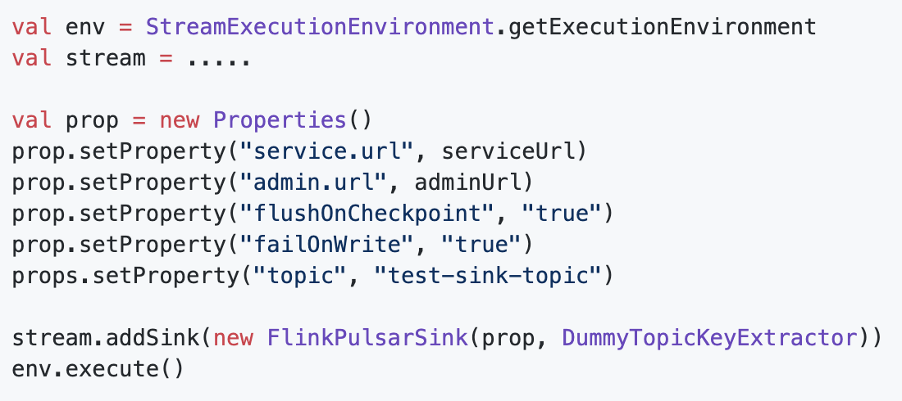
Pulsar-Flink (5) - Pulsar Sink
https://github.com/streamnative/pulsar-flink

Slide 28
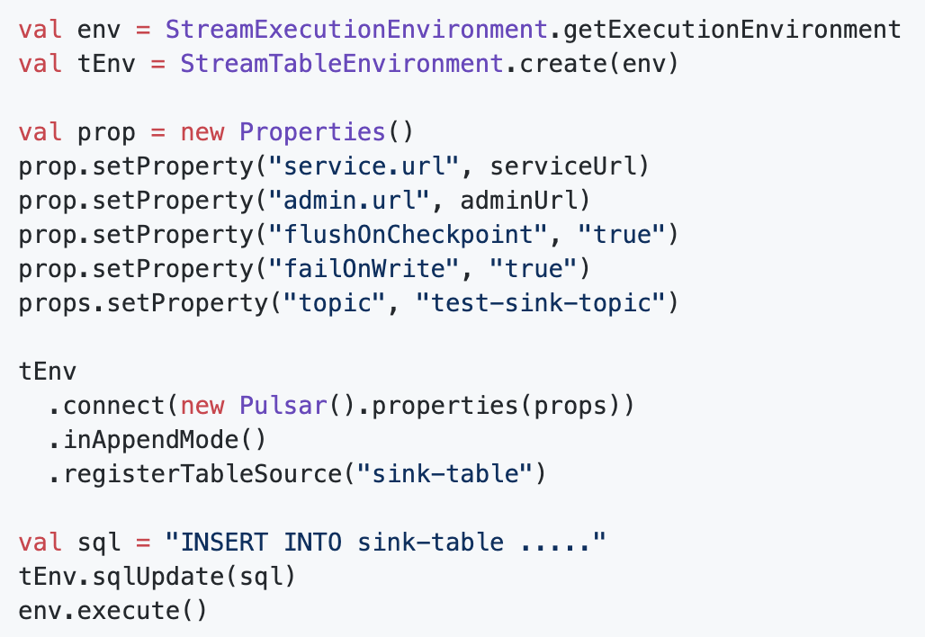
Pulsar-Flink (6) - Write to streaming tables
https://github.com/streamnative/pulsar-flink

Slide 29
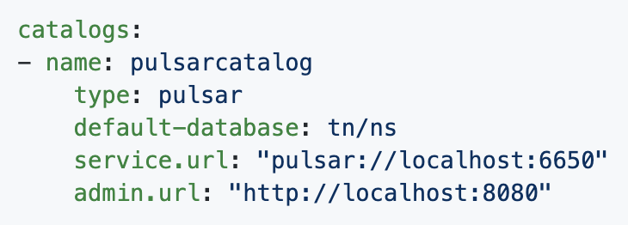
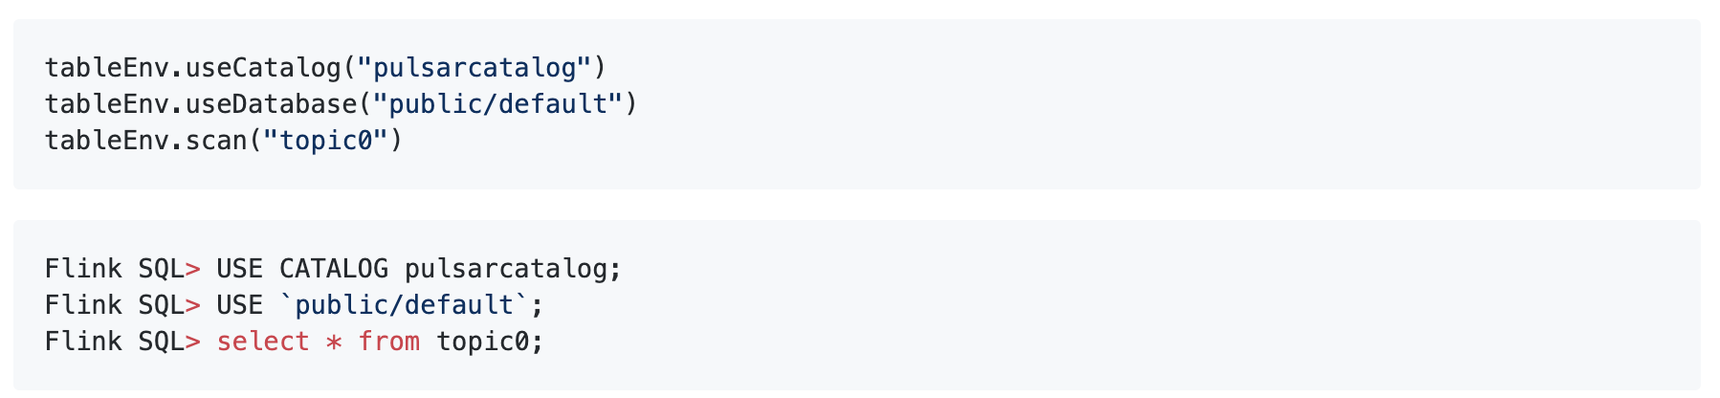
Pulsar-Flink (7) - Pulsar Catalog
https://github.com/streamnative/pulsar-flink

